Slide 1



A Sense of Place: Quick and Dirty Accessibility Analysis Using Open Source Network Analysis Tools
Adam Porr
Research & Data Officer
Mid-Ohio Regional Planning Commission
Ohio GIS Conference
September 20 – 22, 2022

Slide 2
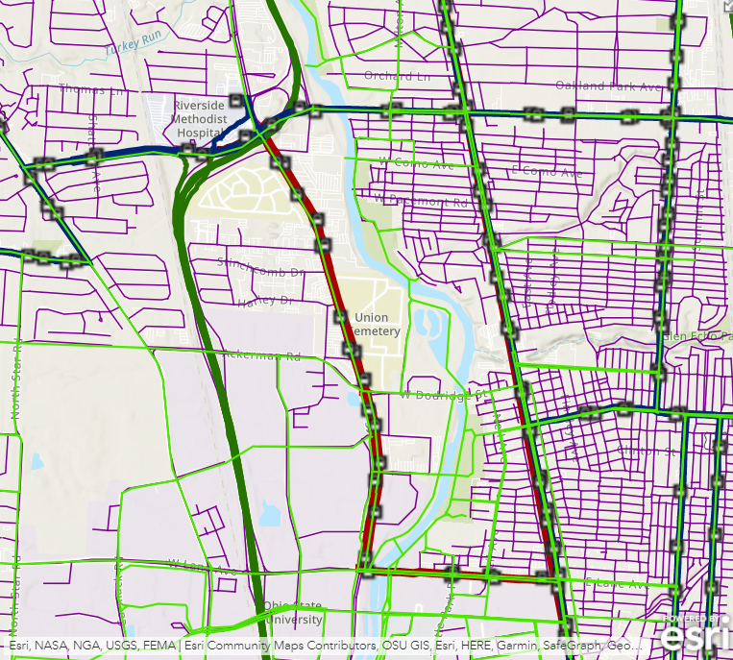
Networks are hard. Multimodal networks are much harder!
Connectivity
Costs
Restrictions
Data availability, attributes, and integration
Also, data and tools can be expensive!
Notes:
Poll: How many have built a car-only street network? How about a multimodal network involving transit? Was it easy?
Look at all the disparate networks shown here and then imagine defining the connectivity, cost functions, and restrictions for them. Networks are hard to build even in the best circumstances.
Input data can also be problematic. In Central Ohio, we are fortunate to have high-quality regional centerline data for the entire region thanks to my colleagues at MORPC and the those of you who maintain the data for your jurisdictions. Statewide, we have centerlines for each county thanks to OGRIP, and statewide centerlines for major roads thanks to ODOT. But what if your study area extends beyond the region or the state? Nationwide datasets are available, but proprietary datasets may be expensive.
Tools can also be expensive. Depending on the application, combined license costs for tools and data could easily reach several thousand dollars, not to mention the labor of building it.

Slide 3

Sometimes you need foolproof routing or research-grade analysis.
Source: NBC
Notes:
Sometimes the high cost is justified. Or, rather, cutting costs might produce unacceptable results, as our friend Michael Scott learned the hard way. If you need the highest accuracy data and full control over network behavior to ensure safe routing guidance or to produce an academically-defensible analysis, then perhaps it makes sense to expend the effort and cost associated with building a network from scratch using local data or purchased proprietary data.
By the way, this is no joke. Don’t believe me? Try Googling “gps car lake”.

Slide 4
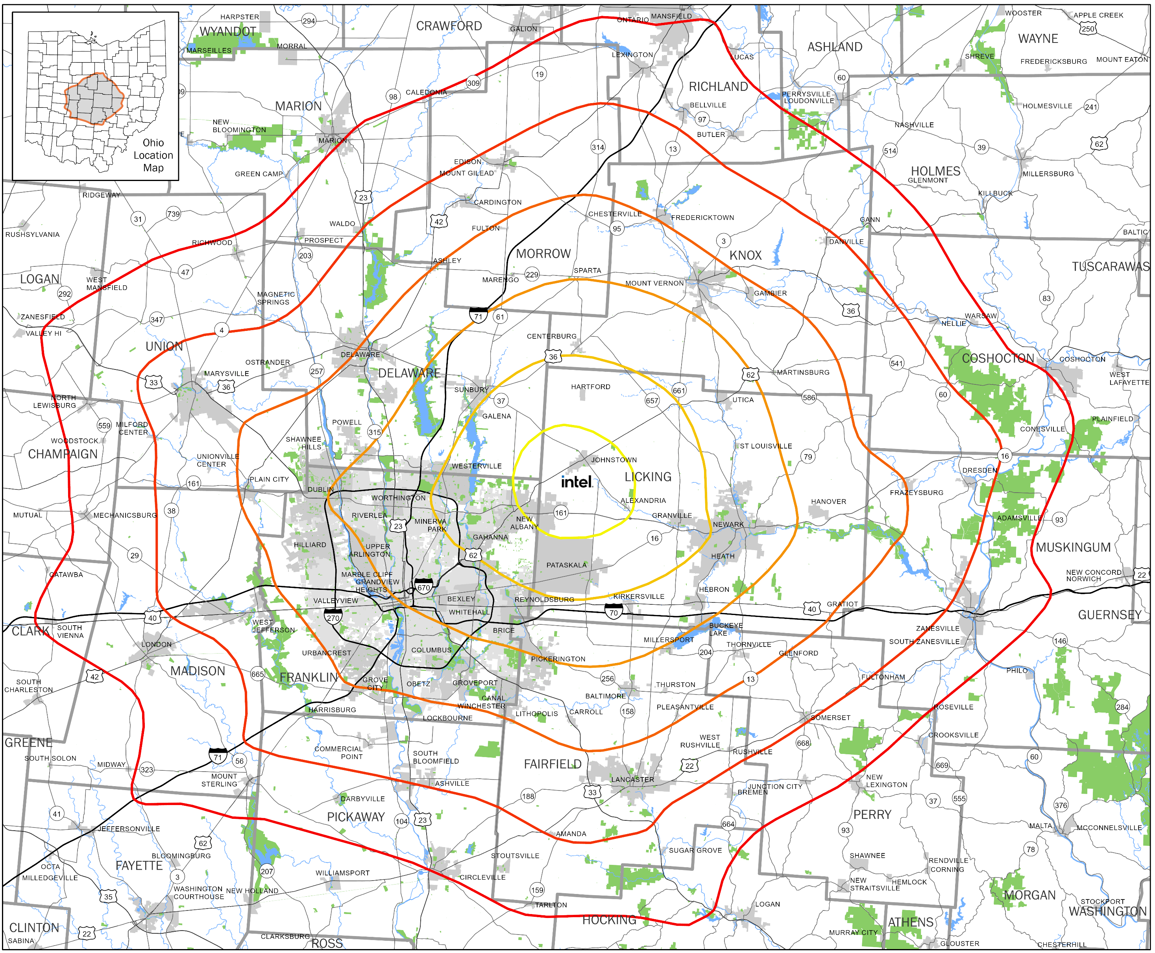
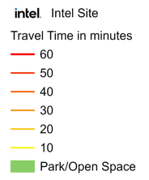
But sometimes you just need a general sense of a place… and the people and things that are nearby.
Source: Extracted from MORPC Intel Site Driving Times map
Notes:
But my purpose today is to convince that there are some applications where this rigor is overkill; where you just need a general sense of a place. In these cases, with appropriate consideration, you may be able to make use of free and open source tools to use network analysis in situations when it would have otherwise been too costly to do so.
For example, take a look at this map. My colleague Cheri put this together in an afternoon and didn’t think much of it, but it was quickly adopted by planners, decision makers, and media outlets throughout the region. Why? Because it does a fantastic job conveying where the Intel site is located relative to other places in the region in a unit of measure – minutes of travel time – that is easily understood. Just visualization. No analysis required. The origin location is represented by a logo the width of Johnstown, and the travel time rings have been greatly simplified, but rather than make it less useful, these changes make it more useful for the intended purpose. The network analysis was done using Esri’s network. If it was done using a network that had minor imperfections, would it be any less useful? Certainly not.
But what if you don’t have access to Esri’s network or network analysis tools? Or what if you need to add some local data that Esri and other providers have not incorporated yet? Or what if you need to incorporate other modes such as transit or scooters or bikeshare?

Slide 5




Luckily, there are (open source) apps for that!
Network of roads, trails, sidewalks, etc.
Network of transit routes (“GTFS”)
“R5” routing engine
(Rapid Realistic Routing on Real-world and Reimagined networks)
One R package to rule them all and on the PC bind them!
Notes:
The analyses I’ll describe today make use of a suite of open source data and applications. These projects are all developed independently, but their layering proves to be incredibly useful for network analysis.
Many of you are probably familiar with OpenStreetMap. This is a global map that anyone with a computer and an email address can edit. Most people experience OSM through the tiled basemaps they provide, but underlying the basemap is an incredibly rich database of point, line, and polygon features, including a routable multimodal network. Although the map is not maintained by a single, central authority, much of the data it contains comes from authoritative sources such as the U.S. Census TIGER program and other national, state, and local governments. Private companies also contribute, and many, many companies make use of OSM in their products for mapping, routing, geocoding and more. Some companies that use OSM for routing include Amazon, Apple, and Strava.
GTFS is a technology that was originally created by Google as “Google Transit Feed Specification”, but is now an open standard known as “General Transit Feed Specification”. GTFS is a standard means by which transit agencies publish their routes, stops, and schedule data for use in apps. A related standard known as GTFS-RT is used to publish realtime vehicle location data.
Conveyal is a company that has developed a routing engine known as “Rapid Realistic Routing on Real-World and Reimagined Networks”, or R5 for short. R5 can automatically build a routable network from OSM and GTFS data, and can incorporate realtime vehicle data and rented vehicle systems.
The R5 engine was developed primarily to support OpenTripPlanner and Conveyal’s own analytics platform, and although it is publicly available under an open source license, documentation is limited and setting it up and using it can be daunting. Thankfully, the Brazillian Institute for Applied Economic Research has created an open source package for the R programming language – known as R5R – which handles the setup and provides a much more user-friendly interface. This component in particular is key to making open source network analysis available to mere mortals like me and you!

Slide 6
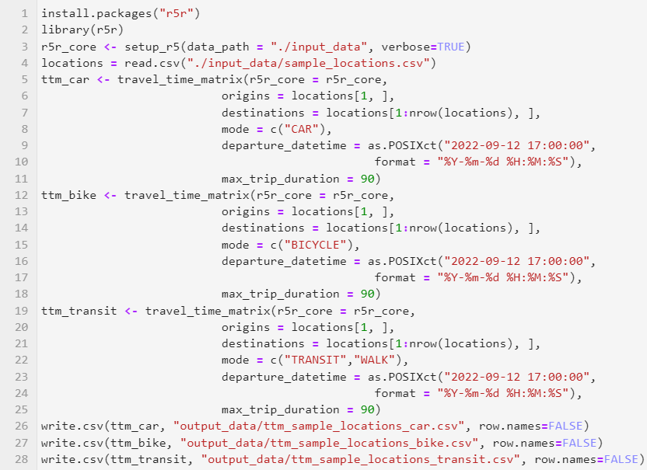
That’s great, but how does it work?
Pre-requisites:
Install R
Download OSM extract (a)
Download GTFS file (b)
Create a spreadsheet with your origin and destination coordinates with fields “id”, “lat”, and “lon”.
https://download.geofabrik.de/
https://cota.com/data/
Notes:
So, how does it work in practice? What you see here is the minimal set of R code required to install the necessary packages, build the network , read in origin and destination locations, and compute travel time matrices for three modes. That’s it; 28 lines!
It is necessary to do a few things before you run the code, specifically:
Install R
Download OSM data
Download GTFS data
Create table of origin and destination coordinates
Then, just run the script using R and watch in amazement! Let me explain briefly what each operation does.

Slide 7
That’s great, but how does it work?
Install and load r5r
Notes:
The first line here automatically downloads and installs the R5R package. This is only necessary the first time you use R5R on your computer.
The second line loads it into memory so it can be used by the script. This happens every time.

Slide 8
That’s great, but how does it work?
Build network from OSM and GTFS
Note: To understand the network in more detail, see: http://docs.opentripplanner.org/en/latest/RouterConfiguration/
Notes:
This is where the magic happens. This command launches the R5 engine and instructs it to build a network comprised of the OSM data and GTFS data you downloaded. It automatically handles things like defining connectivity between the networks, defining default values like walk speed and transit boarding and alighting times, defining costs for various network segments and modes, and much more. The complete list of settings and assumptions is available in the OpenTripPlanner 2 documentation. It is possible to change the default settings when running R5 manually, and is likely possible when running it using R5R, but I haven’t tried this. Some settings (e.g. walk speed) can be easily overridden using R5R.

Slide 9
That’s great, but how does it work?
Load origin and destination coordinates
Notes:
This command reads the CSV file (or it could be an Excel file) containing your origin and destination locations.

Slide 10
That’s great, but how does it work?
Compute travel time matrices for several modes (car, bike, transit)
Note: The full list of configurable parameters is available at: https://ipeagit.github.io/r5r/reference/travel_time_matrix.html
Notes:
Each of these three commands computes a travel time matrix for the mode specified between one origin (the first record in the locations table) and several destinations (the remaining records in the table). For each combination of origin and destination, the command provides the travel time for the fastest route that was identified. R5R allows you to customize many parameters associated with the routing, including departure time, walk and bike speed, maximum travel time for each mode and overall, and more. The full list of configurable parameters is available in the R5R documentation.

Slide 11
That’s great, but how does it work?
Write the matrices to CSV
Notes:
Finally, these commands writes the travel time matrices to CSV files (or you could write them to Excel files instead).
That’s it! Hopefully that seems straightforward enough! But there’s a lot of computation happening here. How long can you expect to wait?

Slide 12
That’s great, but how does it work?
Total runtime:
2.02 minutes
(4 cores @ 3GHz, 16GB RAM)
Notes:
It took about 2 minutes on this laptop, which is a decent computer but nothing special.
The first time the network is built, R5R saves the built version in a file called “network.dat”. If it detects that file when you run the script in the future, it will load the pre-built network, which saves even more time.
Obviously, the run time depends on the size and complexity of the OSM and GTFS data, as well as the number of origins and destinations you’ve specified.
After all of that, what are you left with? A set of CSV files that look like this.

Slide 13
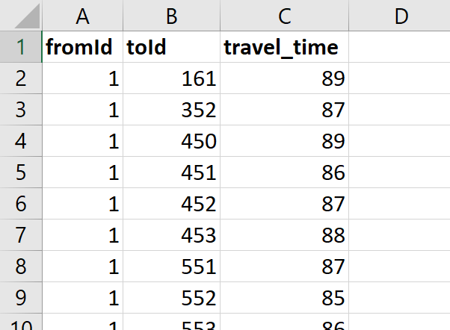
The result doesn’t look very impressive at first…
Notes:
Just three columns. Each record consists of the origin ID, the destination ID, and the fastest travel time between the two.
This isn’t very useful as-is, but…

Slide 14
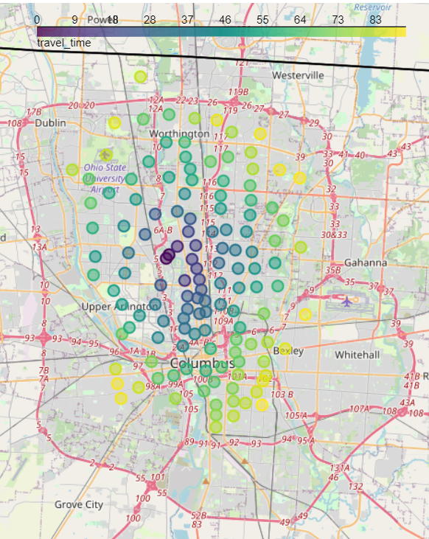
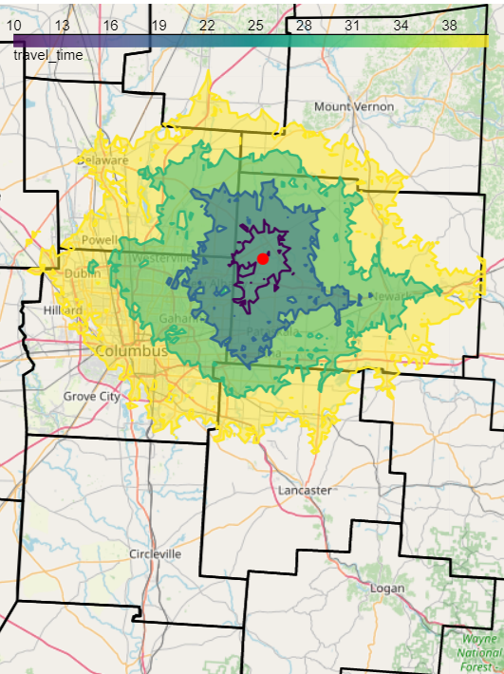
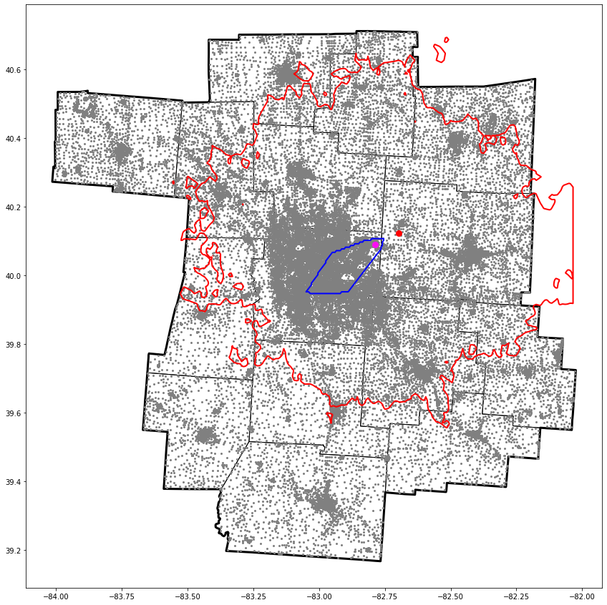
… but with a little GIS work, cool things are possible!
Travel times point-to-point
Travel time rings
Accessibility analysis
Notes:
But with some regular old GIS work, you can do some really interesting analyses. I did the remaining work using open source Python tools, but you could just as easily do it using QGIS or ArcGIS or R, or whatever spatial analysis tool you prefer. I intentionally kept the demonstration code minimal so that you can see that R5R is accessible even to folks who prefer not write code. Incidentally, I’d be happy to share my code if anyone is interested.
The images you see here represent the outputs of a few types of analyses that you can conduct using the travel time matrices. We’ll go through each of these in turn on the following slides.

Slide 15
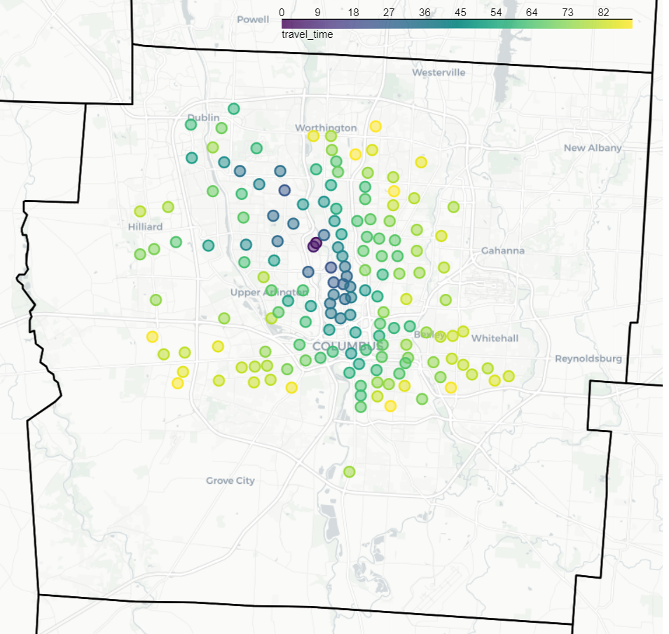
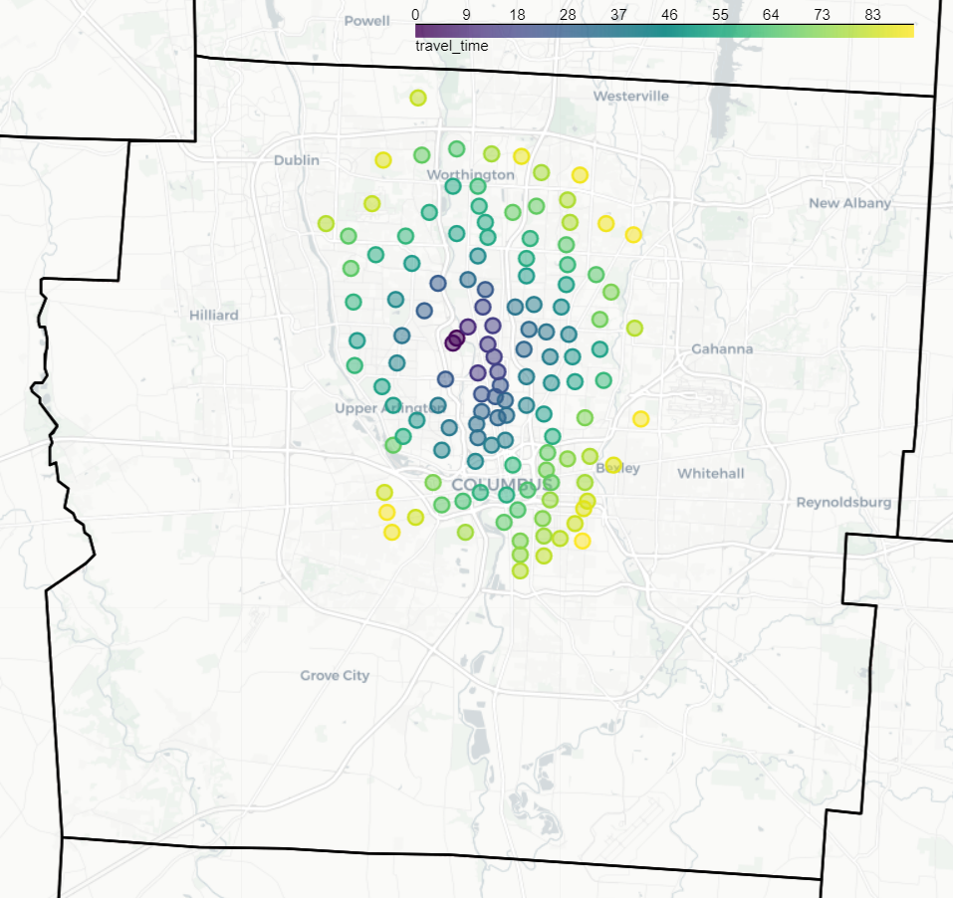
Example - Travel time comparison by mode (from this conference)
Transit
Bike
Notes:
This example is simply a visualization of the travel time matrix where the origin is roughly the location of this conference, and the destinations are census tract centroids that are meant to serve as a loose proxy for neighborhoods. The travel time budget is 90 minutes. Even at this level of resolution you can see the different spatial patterns that different modes of travel produce. Biking results in shorter travel times to more proximate neighborhoods, and even provides better range to the north. Bus provides better range east and west and to the south. Some of the bus destinations appear to be outliers, probably due to express routes with limited stops.

Slide 16
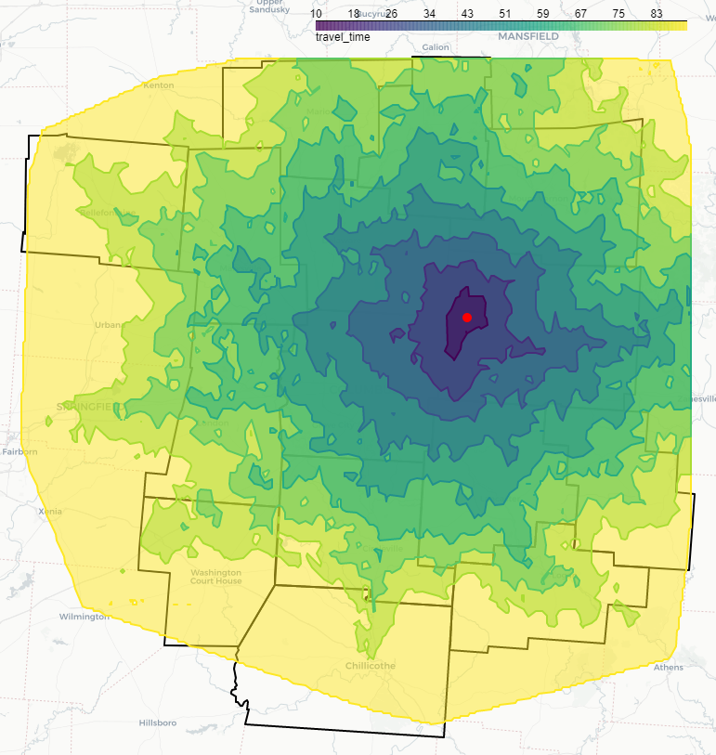
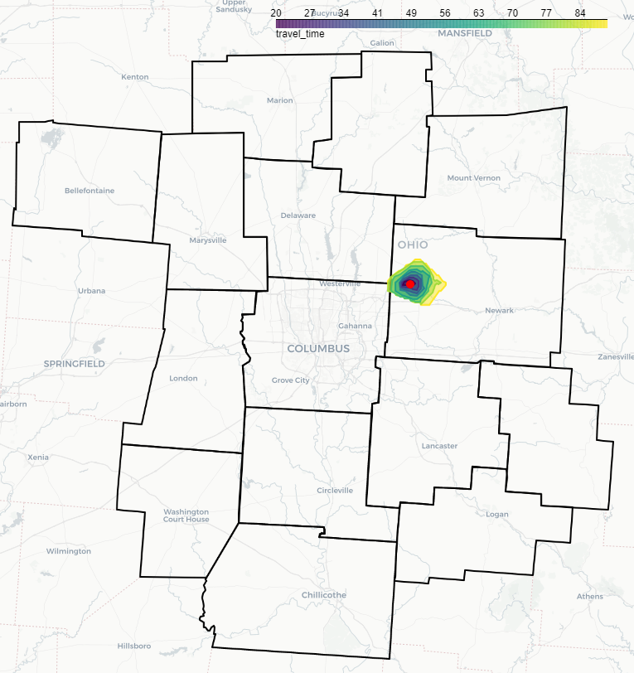
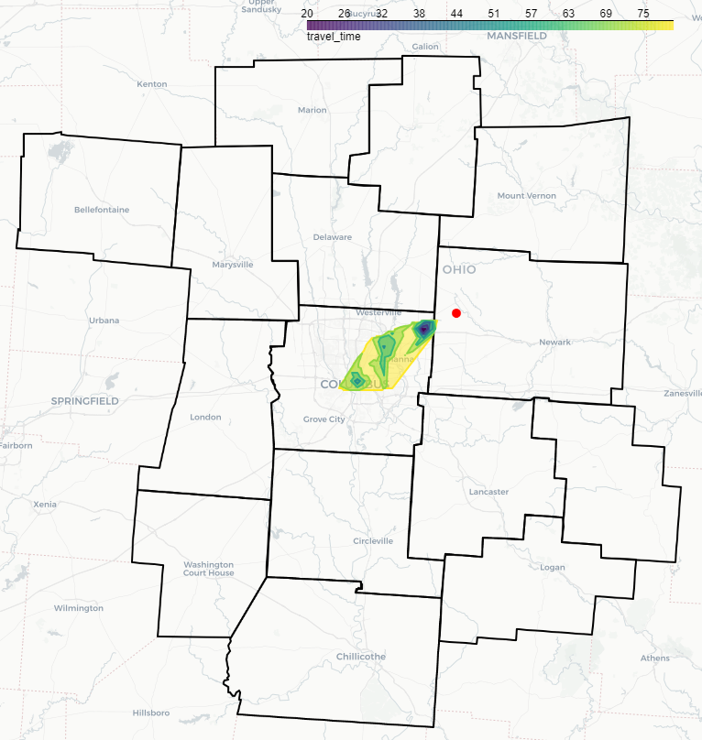
Example - Travel time rings (from Intel site)
Bike
Car
Shuttle + transit
Notes:
Taking the analysis a step further, we can compute travel time rings, or isochrones. This process starts out exactly the same as the previous step, except that we use a high-resolution grid of destination points. Then we can interpolate and compute contours, which produces the polygons you see here. In this case, the origin is the Intel site. It’s probably no surprise to anyone that a car provides the greatest range for the given time budget, which is 90 minutes in this case. In fact, the car’s range is so large that the computation was constrained by the bounding box for the region, which is the limit I used to create my grid.
Let’s take a closer look at the bike and transit results.

Slide 17
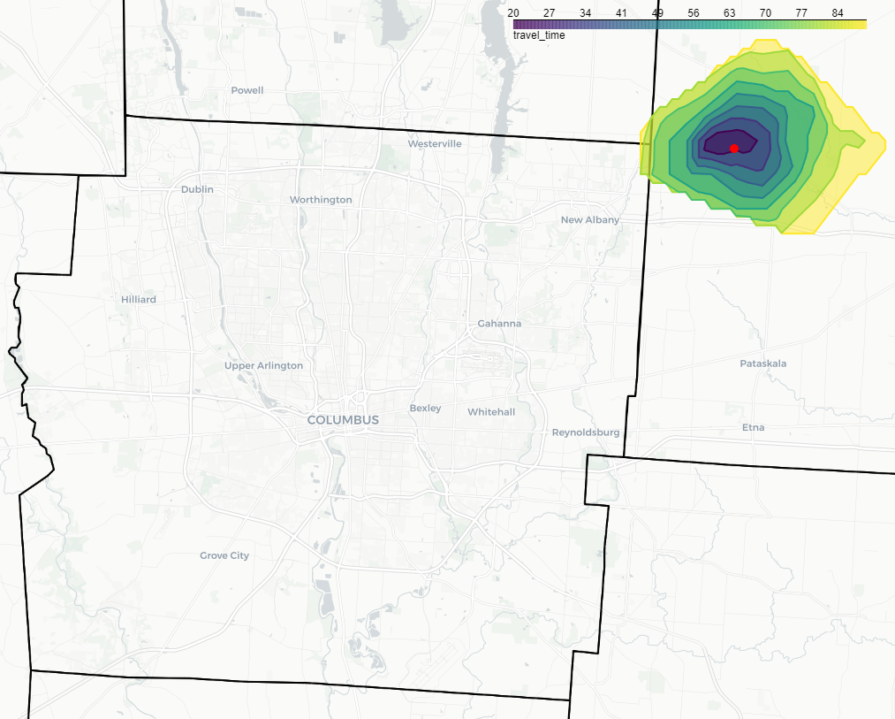
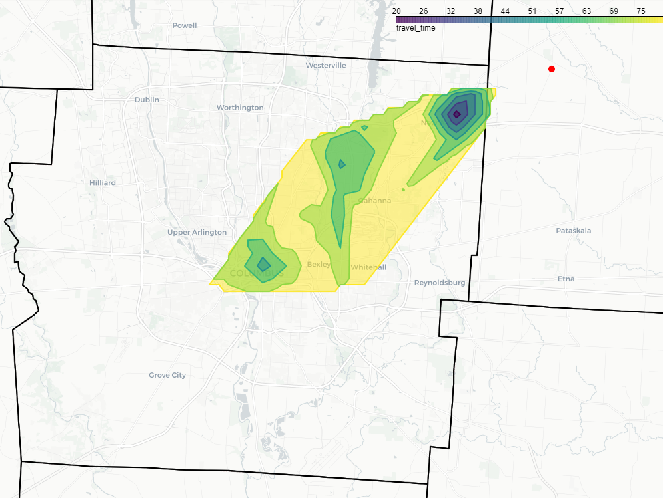
Example - Travel time rings (from Intel site)
Bike
Shuttle + transit
Notes:
A few things to note here. Biking was allowed on all roads except interstates (presumably). It is possible to limit biking to roads below a certain “level of traffic stress”, but the OSM data for Central Ohio does not seem to include LTS.
The transit case is a bit of a hack. There is a park and ride in New Albany, which is served twice a day by COTA’s route #45. In theory, it should have been possible to compute trips that originated at the Intel site by bike, then transferred to transit at the park and ride, however I could not get the router to identify this trip. Instead, I simulated a shuttle from Intel to the park and ride, by originating the routing at the park and ride and removing 10 minutes from the time budget to account for the transfer from Intel to the park and ride. As you can see, this express bus results in some strange and interesting travel time patterns!
These maps look pretty and may indeed produce some insights, but we can also use the isochrones for more quantitative analyses.

Slide 18
Example – Accessibility analysis
Notes:
Accessibility analysis is the use case for R5R that I find most compelling as an urban planner. If any of you were brave and/or kind enough to attend this presentation after hearing my presentation last year, you might recall that by accessibility I mean the number of “opportunities” that are reachable on the network given a set of conditions. Opportunities often refers to things like jobs, health care facilities, or grocery stores that can be accessed by a single representative person. In this case, I’m going to bend the meaning somewhat to refer to the number of people who have access to a single facility, namely the nascent Intel plant.
In this map, the gray dots represent census block centroids. Each centroid includes the population of block as an attribute. Thus, if I overlay the travel time polygons from the previous slides on the dots, I can determine which dots are in range of the plant for a given time budget and mode.

Slide 19
Example – Accessibility analysis
Notes:
As it turns out, shuttle+transit provides access to about 300k people while car provides access to over 2M people. And then only two times per day at the beginning and end of the standard work day. This may serve the professional staff well enough, but the timing may not be very helpful for the fabrication staff depending on when shifts start and end. Clearly additional bus service is needed if the Intel and our region are serious about sustainability and reducing vehicle miles traveled!
This information is potentially useful when considering the impacts of the Intel development, but there are some potential extensions that might improve the accuracy of the analysis or contemplate future changes.

Slide 20
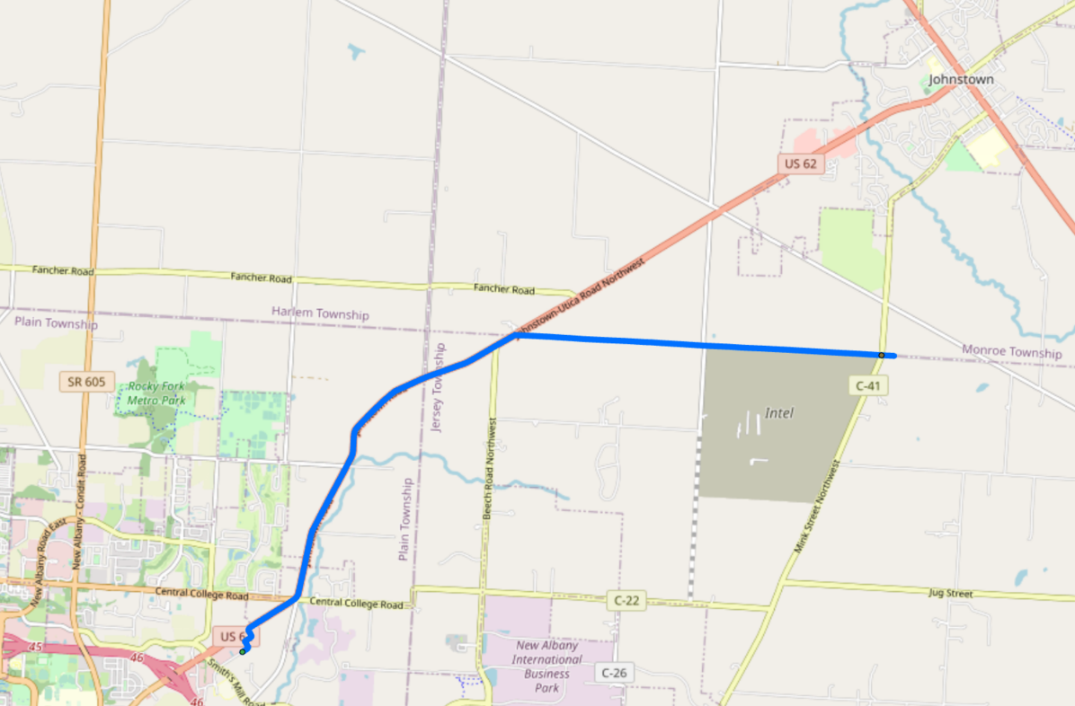
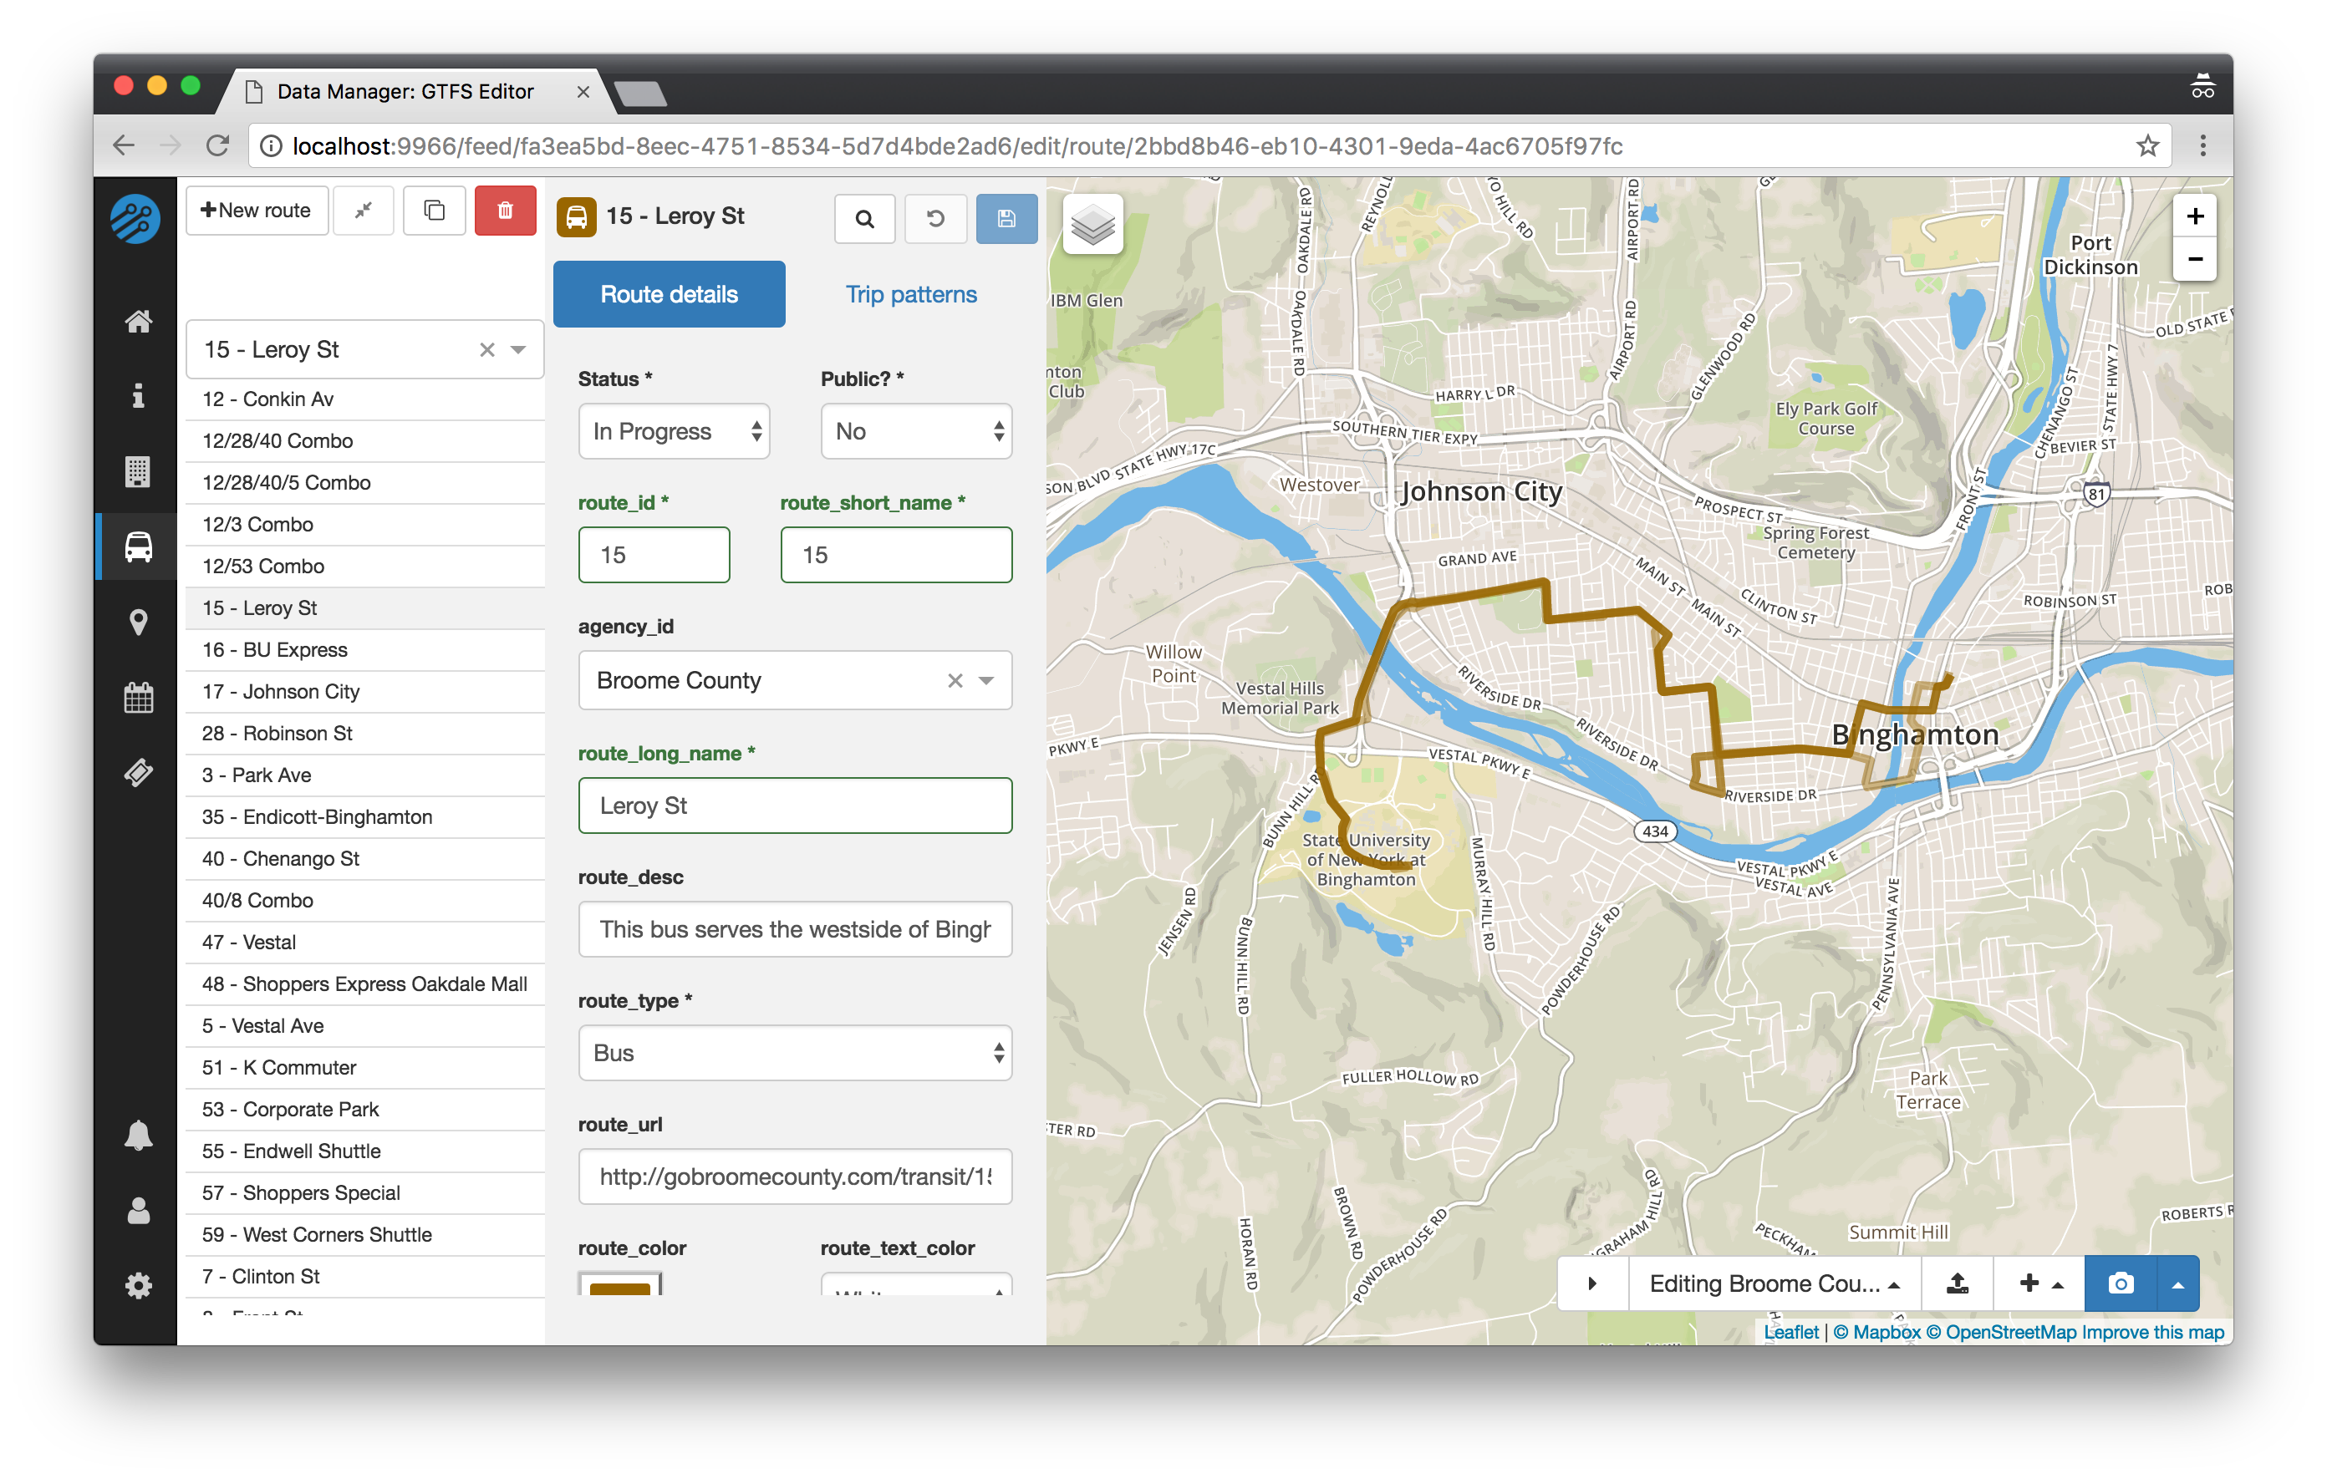
What if we were to…
…model a new COTA stop at the Intel site?
…model a new fixed-route service to serve Licking County?
…model a new bike path between the site and the New Albany park and ride and/or Johnstown?
…improve the OSM data?
Feature completeness (esp. bike/ped)
Attribute completeness (Level of Traffic Stress)
Source: https://data-tools-docs.ibi-transit.com
Notes:
For example, what if we were to use these tools to:
Model a new COTA stop at the Intel site. How would the travel patterns change based on the new stop, and/or increased frequency of the route? Because R5R accepts GTFS as an input, we can easily edit the GTFS data to incorporate such changes.
GTFS is just comprised of CSV files, so adding a stop or changing the frequency should be simple enough, but what if we wanted to model an entirely new route, say a fixed route service in Licking County. In that case, a special GTFS editor may be warranted. Fortunately, open source tools exist for that too.
As you can see from the top image, a cycle route from the Intel site to the New Albany Park and Ride includes some fairly major roads. What alternate routes exist, and what penalty does a cyclist pay for selecting another one. What if a dedicated bike route was created between the plant and the park and ride that reduced the distance, reduced the cyclist stress level, or both?
Finally, how could the OSM data be improved to produce a more accurate network? How would the network and the results of the analysis change if the features were more complete and had richer attributes such as level of traffic stress.
This presentation has focused mostly on accessibility, but I’d be remiss if I didn’t mention that R5R can produce multi-model itineraries as well.

Slide 21
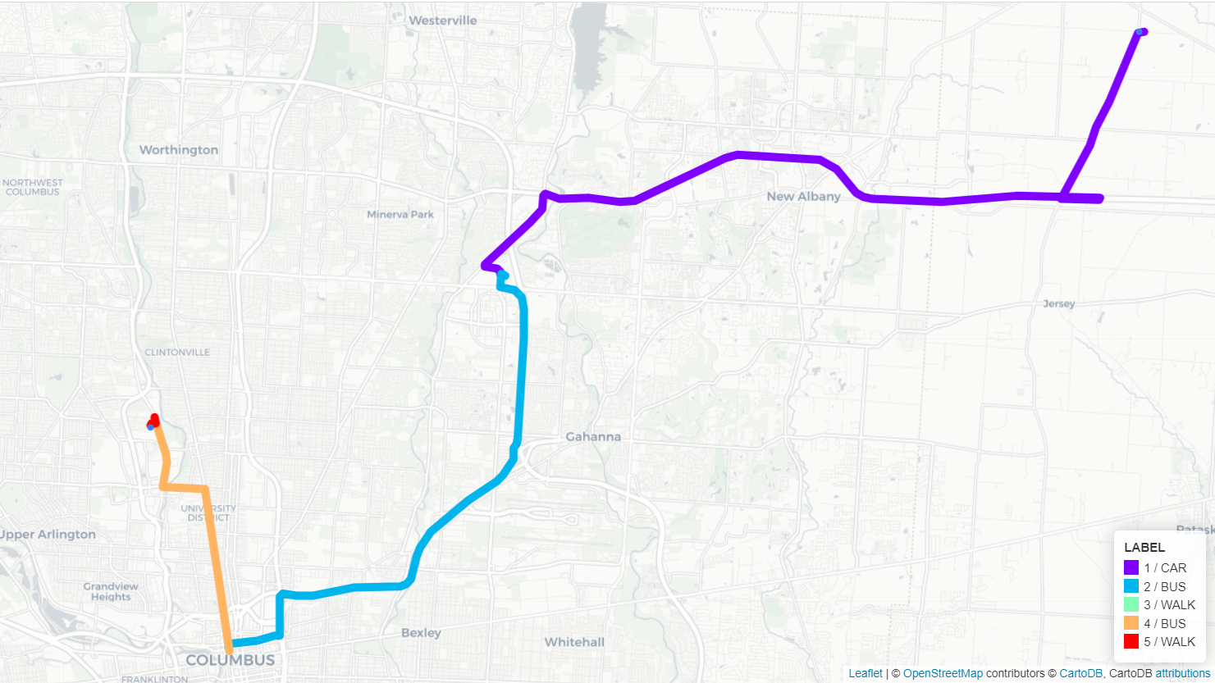
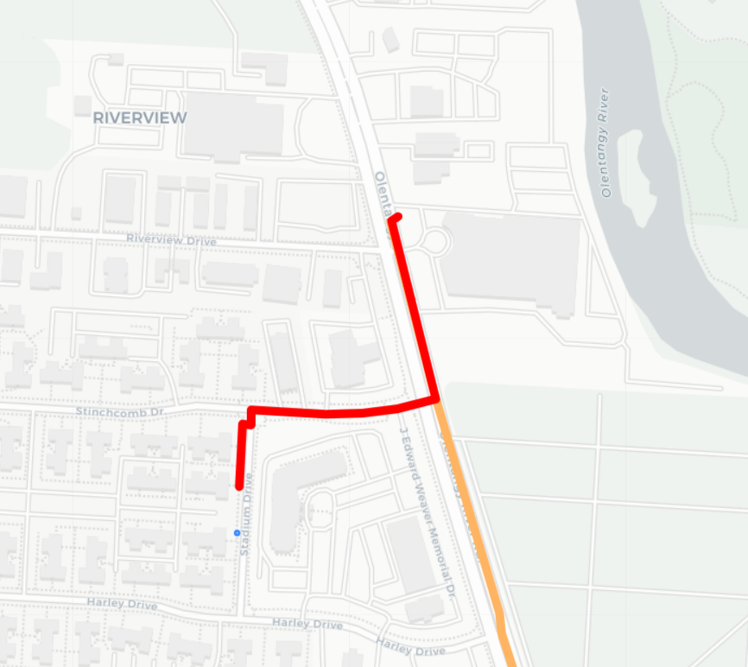
Naturally, it can generate itineraries too.
Trip time: 88.65 minutes
Walking distance: 504 meters
Notes:
For example, take a look at this itinerary, which shows a multi-modal route from the Intel site to a location near this conference venue leaving at 5pm. The first leg is by car (perhaps a carpool), followed by transfer in the Easton area to a downtown bus, then a transfer to another bus, and finally a short walk. R5R provides the line feature for each leg, as well as the mode of travel, the transit route (if applicable) and some statistics about travel and wait time. In this case, the trip time was about 89 minutes and the walking distances is about half a kilometer.

Slide 22
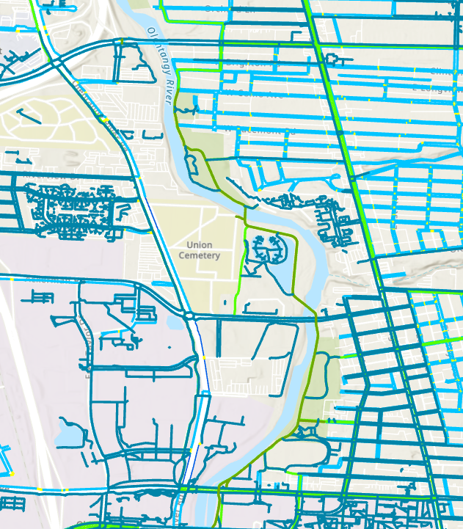
Lessons learned and caveats
R5R doesn’t (yet) provide access to all features of R5 (e.g. custom ingress modes)
Computation of inbound routes is much slower than outbound routes?
Couldn’t get router to allow boarding at New Albany Park and Ride
OpenStreetMap network isn’t perfect in Central Ohio…
Incomplete sidewalks
Incomplete greenways
No Level of Traffic Stress
… and yet, many companies are selling or relying on OSM-based products!
Need to fully understand or fine tune network behavior? Stick with ArcGIS (for now)
There is a Python equivalent (r5py), but it doesn’t seem as mature or functional as r5r (yet).
Notes:
Now I need to confess to you all that I’m a charlatan. When I agreed to do this presentation, I had done plenty of network analysis and accessibility analysis, and I had used the similar tools available in OpenTripPlanner but I had never used R5R before. In the process of preparing this material, I came to learn that R5R is an incredibly useful tool and I think it is appropriate for a certain class of applications. I did want to point out a few caveats and lessons learned, however.
R5R doesn’t (yet) provide access to all features of R5 (e.g. custom ingress modes)
Computation of inbound routes is much slower than outbound routes?
Couldn’t get router to allow boarding at New Albany Park and Ride
OpenStreetMap network isn’t perfect in Central Ohio…
Incomplete sidewalks
Incomplete greenways
No Level of Traffic Stress
… and yet, many companies are selling or relying on OSM-based products!
Need to fully understand or fine tune network behavior? Stick with ArcGIS (for now)
There is a Python equivalent (r5py), but it doesn’t seem as mature or functional as r5r (yet).
Finally, if you are convinced that this is useful but you’d prefer a simpler interface, you could try Conveyal’s analytics tool.

Slide 23
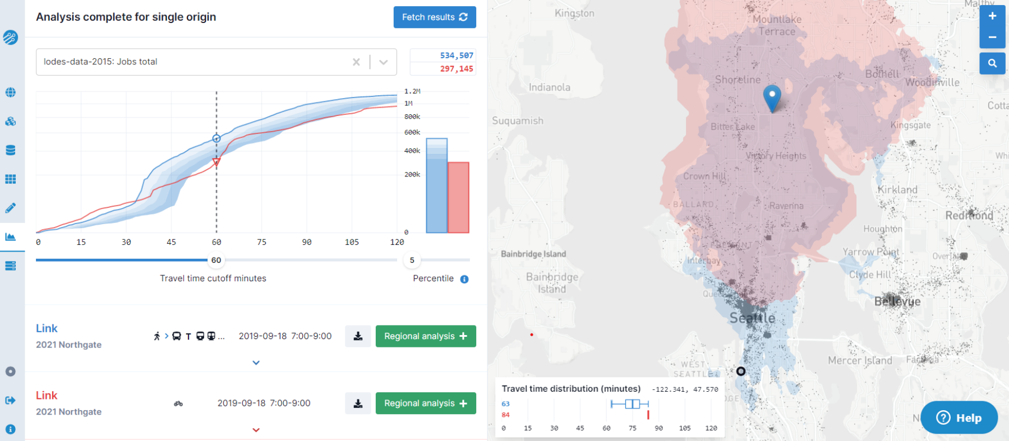
Does this sound like too much work? Try Conveyal!
https://conveyal.com/
Notes:
Conveyal is the developer of the R5 engine and they’ve built a web based analysis tool to run on top of it and make it easy for people to use. The has many capabilities, but in a nutshell it specializes in allowing you to compare the accessibility changes resulting from different transportation scenarios. It includes tools for sketching out those scenarios by making changes to a local copy of the road network or transit network. I haven’t used it extensively, but spent a few hours playing with it and it seems very powerful.
Conveyal offers this tool as a paid service, but you can also download it and set up your own instance. I can attest that it is possible to run a Conveyal instance on your own server (or even on your PC), however it requires some system administration skill to do this.
I don’t have any affiliation with Conveyal, but I wanted to mention them because I’m grateful that they make their software available to the public at no cost.

Slide 24
Thank you! Questions?
Source code: https://github.com/aporr/r5r-demo
Notes:
That brings us to the end of my presentation. Thanks for spending this session with me. I hope you found some of this useful, and I’ll be happy to take any questions!

Slide 25
Unused slides
Notes:
That brings us to the end of my presentation. Thanks for spending this session with me. I hope you found some of this useful, and I’ll be happy to take any questions!

Slide 26
Background information
Accessibility: The number of opportunities reachable on the network given a set of conditions.
History
Publications
2009: OpenTripPlanner brings multi-modal point-to-point routing, but limited accessibility tools.
2016: R5 brings accessibility tools, but intended for OTP2 and Conveyal Analysis platform. Not well documented or easy to use.
2020: R5R brings the power of R5 to mere mortals through bundling of the engine and a simple interface.
Stewart and Byrd (2021): Interactive Access for Integrated Planning. Chapter 17 in Applications of Access
Conway and Stewart (2019): Getting Charlie off the MTA: a multiobjective optimization method to account for cost constraints in public transit accessibility metrics
Conway, Byrd, and van Eggermond (2018): Accounting for uncertainty and variation in accessibility metrics for public transport sketch planning
Conway, Byrd, and van der Linden (2017): Evidence-Based Transit and Land Use Sketch Planning Using Interactive Accessibility Methods on Combined Schedule and Headway-Based Networks

Slide 27
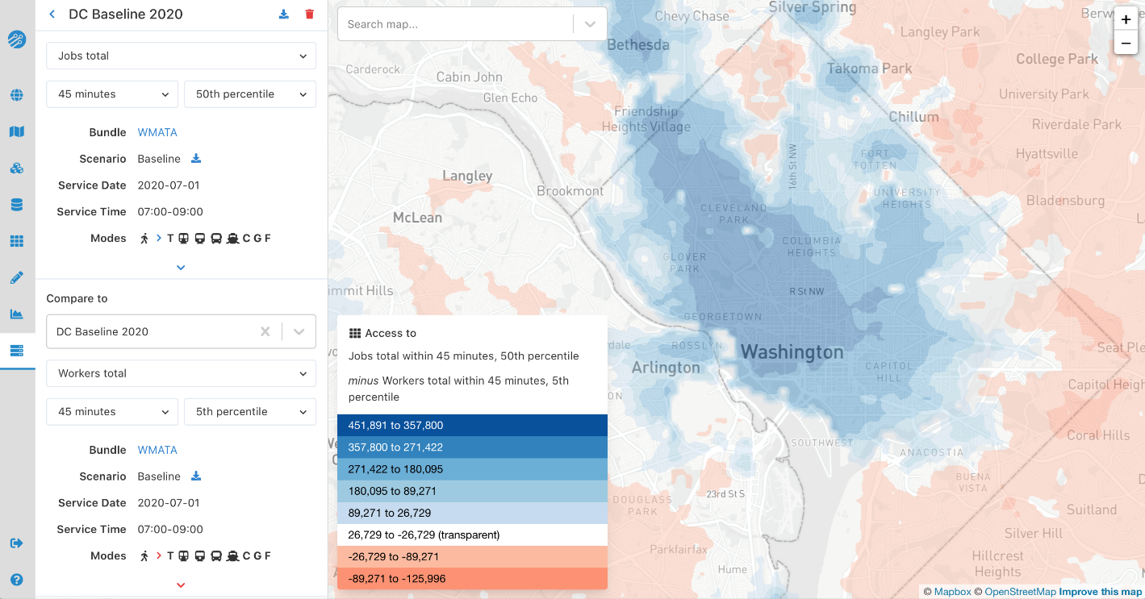
Another Conveyal screenshot
https://conveyal.com/

Slide 28
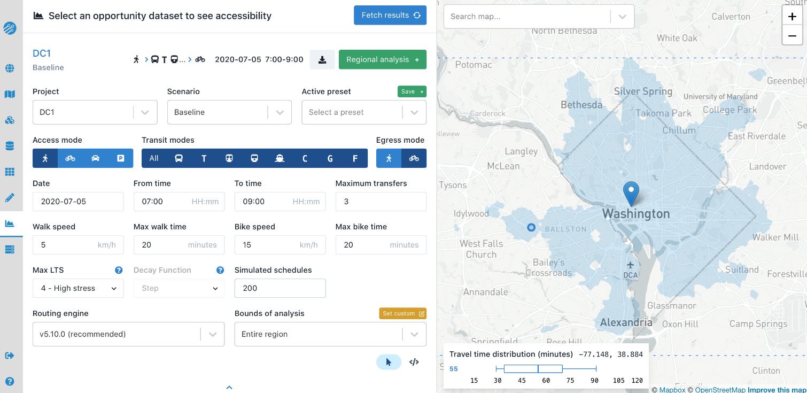
Another Conveyal screenshot
https://conveyal.com/

